Slide 1



HUM 102 Report Writing Skills
Lecture 04

Slide 2
Previous Lecture
Title Page
Executive Summary
Table of Contents
Introduction

Slide 3

Report Structure: Sections
Title Page
Executive Summary
Table of Contents
Introduction
Discussion
Conclusion
Recommendations
Bibliography
Appendices

Slide 4
Report Structure: Sections
Title Page
Executive Summary
Table of Contents
Introduction
Discussion
Conclusion
Recommendations
Bibliography
Appendices

Slide 5
Report Structure: Discussions [1/3]
Discussion explains:
What exactly you accomplished?
What problems you encountered (status report)?
What you saw and did (trip report)?
What procedure you followed?
What you learned from the task (laboratory report)?
What options exist as feasible solutions to a problem (proposal)?

Slide 6
Report Structure: Discussions [2/3]
Author’s reflection on the subject matter
Author's expression of his/her own opinions and views
Indicates how to provide solution to the problem
Good prose style
Justified arguments or generalizations

Slide 7
Report Structure: Discussions [3/3]
To think critically about an issue.
To develop creative solutions to the problems.
To formulate a deeper, more profound understanding of the problem under investigation.

Slide 8
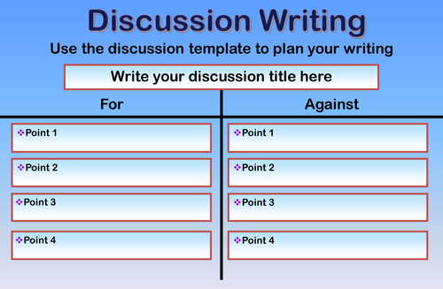
Report Structure: Template

Slide 9
Report Structure: Findings
How reliable are the findings?
How significant are the findings?

Slide 10
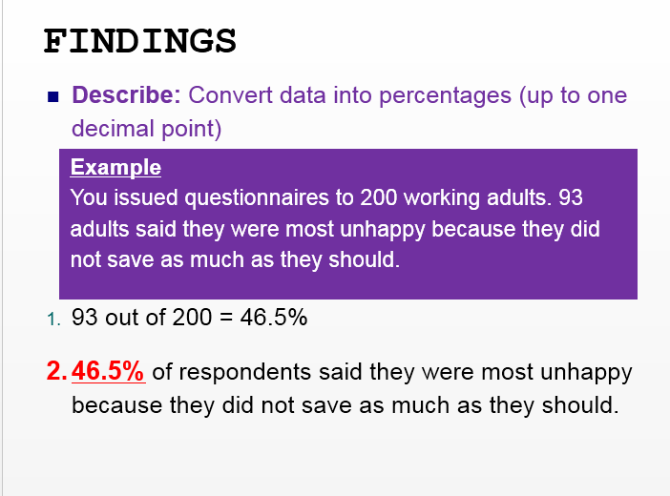
Findings Examples

Slide 11
Report Structure: Conclusions
Conclusions:
are logical deductions based on the data in the findings section.
are a comprehensive summary of the findings.
sum up the main points of the report.
highlight the significant elements.
relate to the objectives.
end with a statement which will lead to the recommendations section.

Slide 12
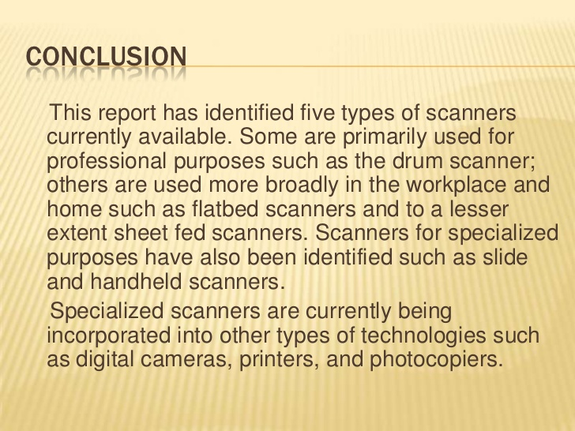
Example: Conclusions

Slide 13
Report Structure: Recommendations
Recommendations can be made concerning:
the implementation
general applicability
suitability of findings
suggestions of topics for further research

Slide 14
How to write Recommendations?
Brief – write concisely; any reason for recommendation should only be given if necessary.
Clear – do not be ambiguous as to how the suggestion should be implemented.
Precise – vague recommendations usually result from insufficient research/analysis.

Slide 15
Bibliography or Work Cited
All the sources of information are included in the report.
Use the standard format: APA/MLA
Ensure that all the work you cite in the body of your report is listed in the reference list.

Slide 16
Appendices
An appendix contains material which is too detailed, technical, or complex to include in the body of the report .
Example:
Specifications
Questionnaire
Long complex table of figures etc.
Placed at the very end of the report.

Slide 17
Conclusions
Discussions
Findings
Conclusions
Recommendations
Appendices

